Slide 1

Risk Management Software System
Cs-591 course project
Jaswanth sunkara

Slide 2
#.NO | TITLE | PAGE-NO
1 | INTRODUCTION | 3
2 | TOP 10 RMS SYSTEMS | 4
3 | COMPARISION OF RMS SYSTEMS | 5
4 | SOFTWARE ENGINEERING MODEL | 7
5 | PROJECT SCOPE | 8-9
6 | HUMAN RESOURCE MANAGEMENT PLAN | 10-12
7 | ROLES AND RESPONSIBILITY MATRIX | 13
8 | TIME MANAGEMENT PLAN | 14-16
9 | COST MANAGEMENT PLAN | 17-19
10 | RISK MANAGEMENT PLAN | 20-23
11 | FP & LOC BASED ESTIMATION | 24-25
12 | STATEMENT OF WORK | 27-28
13 | REQUEST FOR PROPOSAL | 29-31

Slide 3
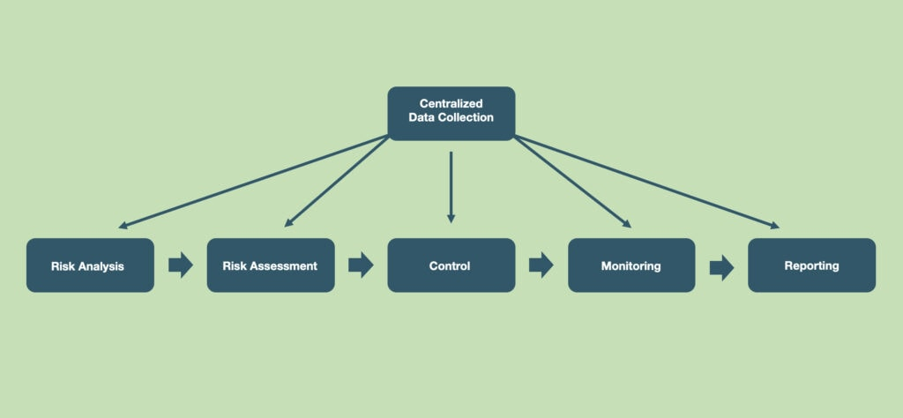
What is Risk Management Software
Risk management software helps you identify, assess, and document risks associated with running various business processes and IT assets, communicate about risks, and efficiently manage risk mitigation tasks
Source - Risk Management Software - Function & Application | OTRSmag

Slide 4
List of identified Risk Management Software Systems
1.Archer - Integrated Risk Management | Archer (archerirm.com)
2.Metricstream - GRC | Governance, Risk and Compliance Software Solutions (metricstream.com)
3.LogicManager - LogicManager | Enterprise Risk Management Software & GRC Solutions
4.Diligent - Diligent Corporation | A Modern Governance Company
5.Servicenow - Risk Management – GRC – ServiceNow
6.Sai360 - ESG, GRC & EHS&S Software & Learning for Risk & Compliance– SAI360
7.Resolver - Resolver | Discover The Value Of Risk Intelligence
8.OneTrust - Third-Party Risk | OneTrust
9.Riskonnect - Risk Management Software Solutions - Riskonnect Inc.
10.LogicGate - LogicGate Risk Cloud | GRC Software | Enterprise Risk, Governance + Compliance Solutions

Slide 5
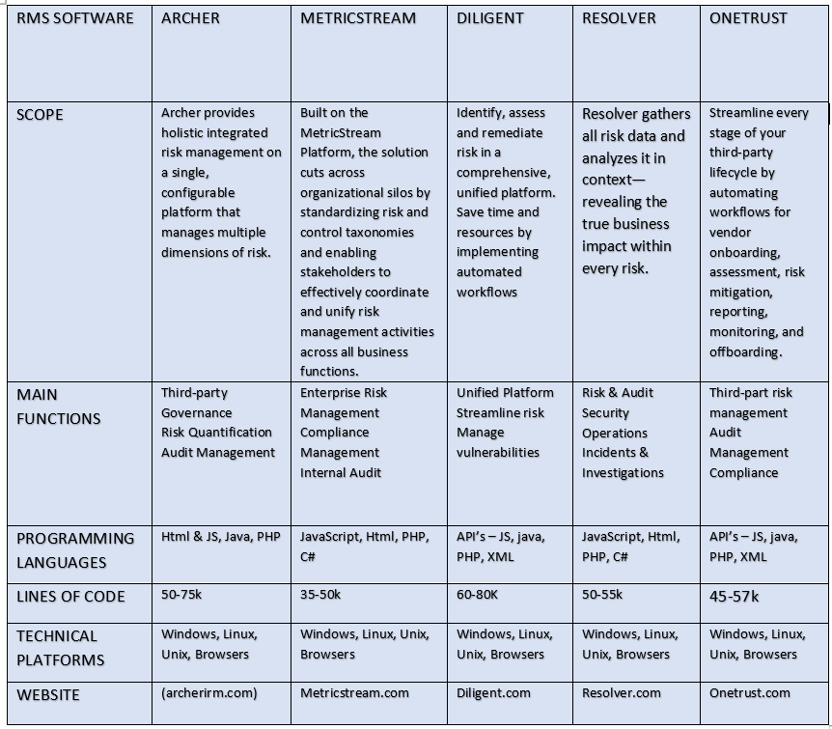
Comparitive ANALYSIS

Slide 6
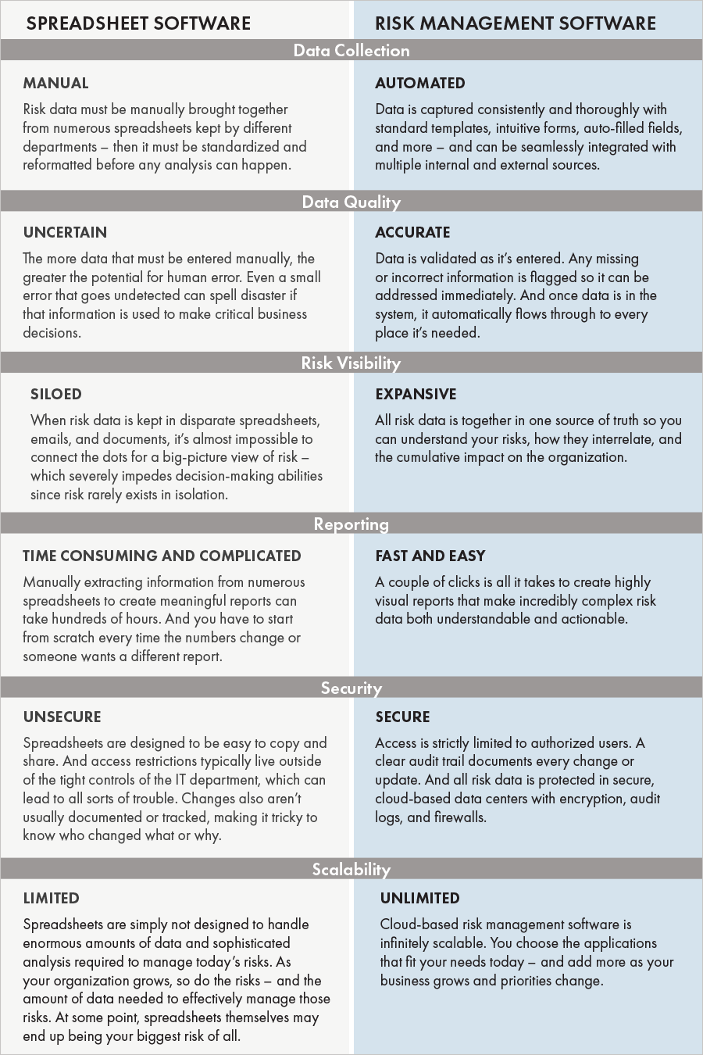
SPREADSHEET VS RMS-SOFTWARE
Source - Spreadsheet Software vs Risk Management Software: A Side-by-Side Comparison · Riskonnect

Slide 7
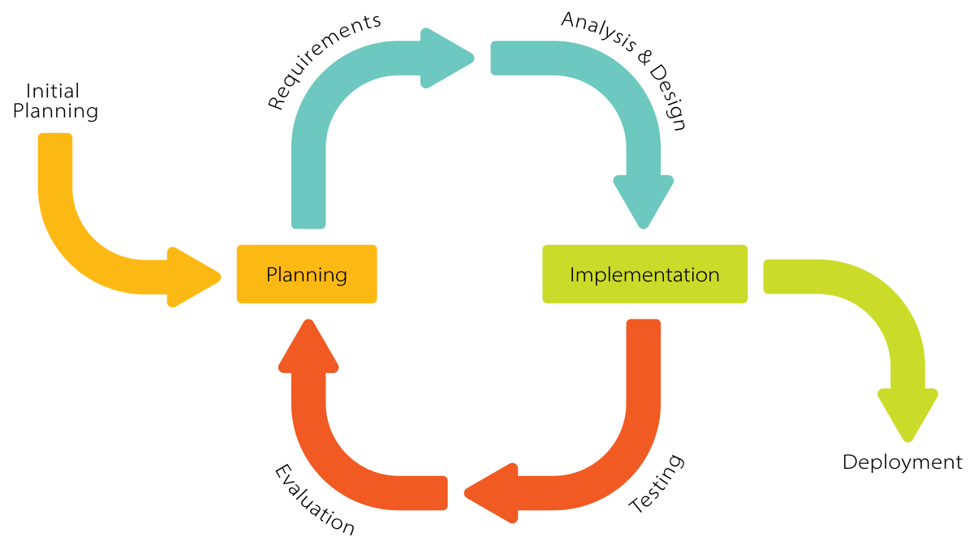
SDLC Model – Incremental model
Incremental Model is a process of software development where requirements divided into multiple standalone modules of the software development cycle. In this model, each module goes through the requirements, design, implementation and testing phases. Every subsequent release of the module adds function to the previous release. The process continues until the complete system achieved.
Source - Incremental Model (Software Engineering) - javatpoint

Slide 8
3.PROJECT SCOPE
FUNCTIONAL REQUIREMENTS
Non-functional requirements
Log risk data
Track and manage risks
Track changes
Risk register
Reviewing risks and treatment plans
Control access of risk data
Risk report
Usability
Reliability
Performance
Security
Data integrity

Slide 9
CONSTRAINTS
Database Server : SQL Server for database tools
Programming Languages : JS, Java, C#, html & CSS, XML.
Supported Operating Systems : Windows, Mac OS X, Linux, UNIX
IDE tools : VISUAL STUDIO, Oracle.
Software : ms-excel
Hardware Requirements
Processor : 64 bit
Memory : 4 GB
Hard disk : 5 GB

Slide 10
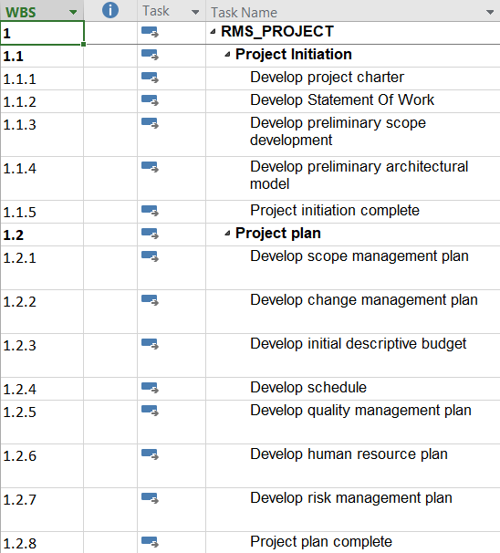
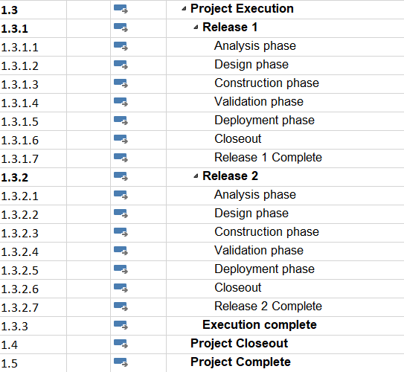
HUMAN RESOURCE MANAGEMENT PLAN

Slide 11
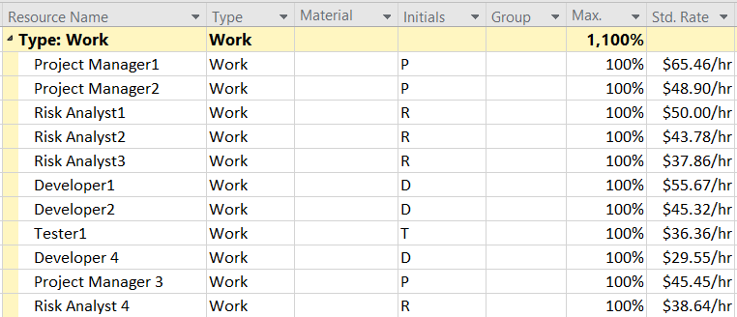
List of required human resources

Slide 12
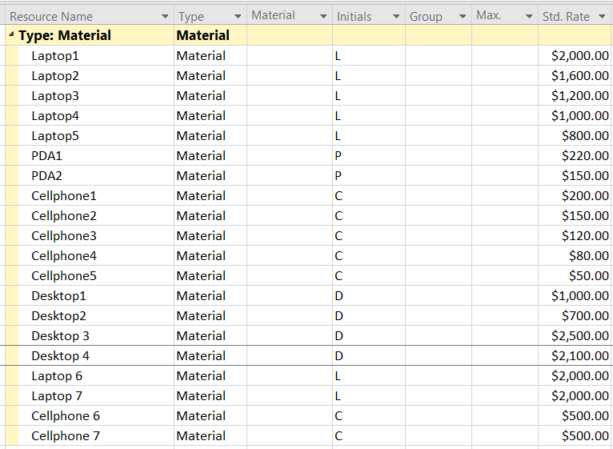
List of required material resources

Slide 13
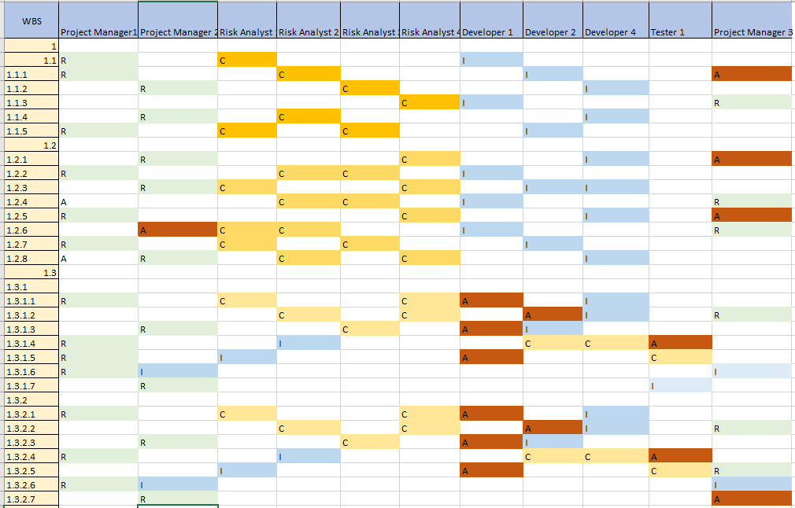
ROLES AND RESPONSIBILITY MATRIX

Slide 14
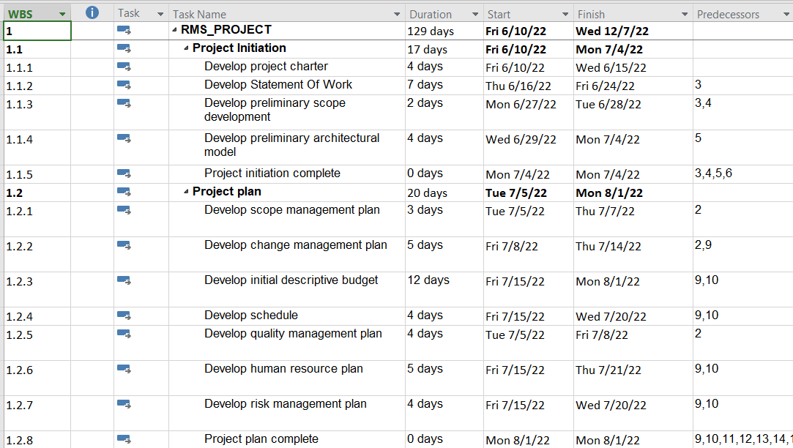
TIME MANAGEMENT

Slide 15
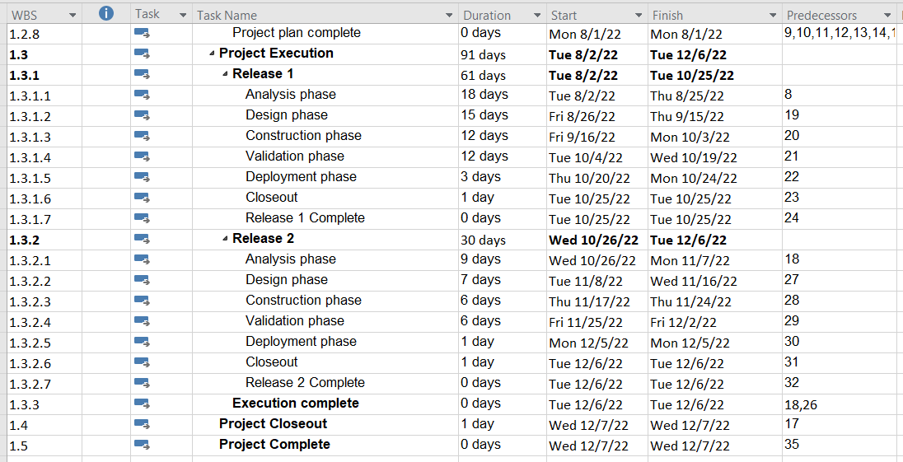

Slide 16
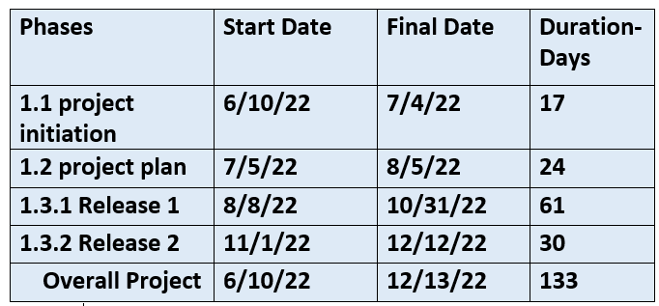
TOTAL PROJECT TIME

Slide 17
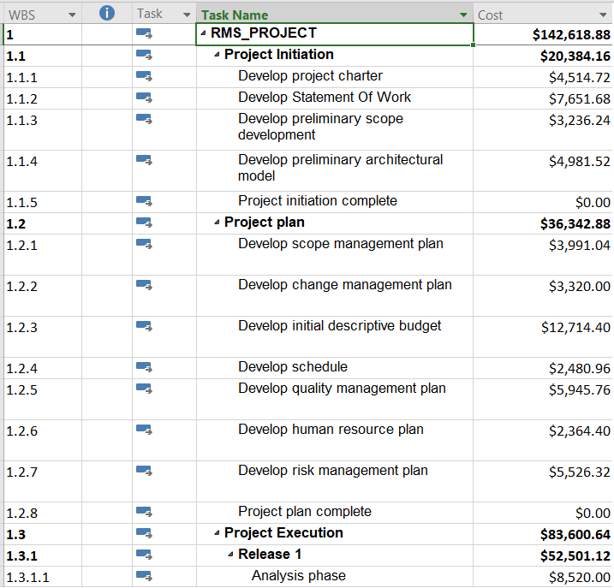
COST MANAGEMENT

Slide 18
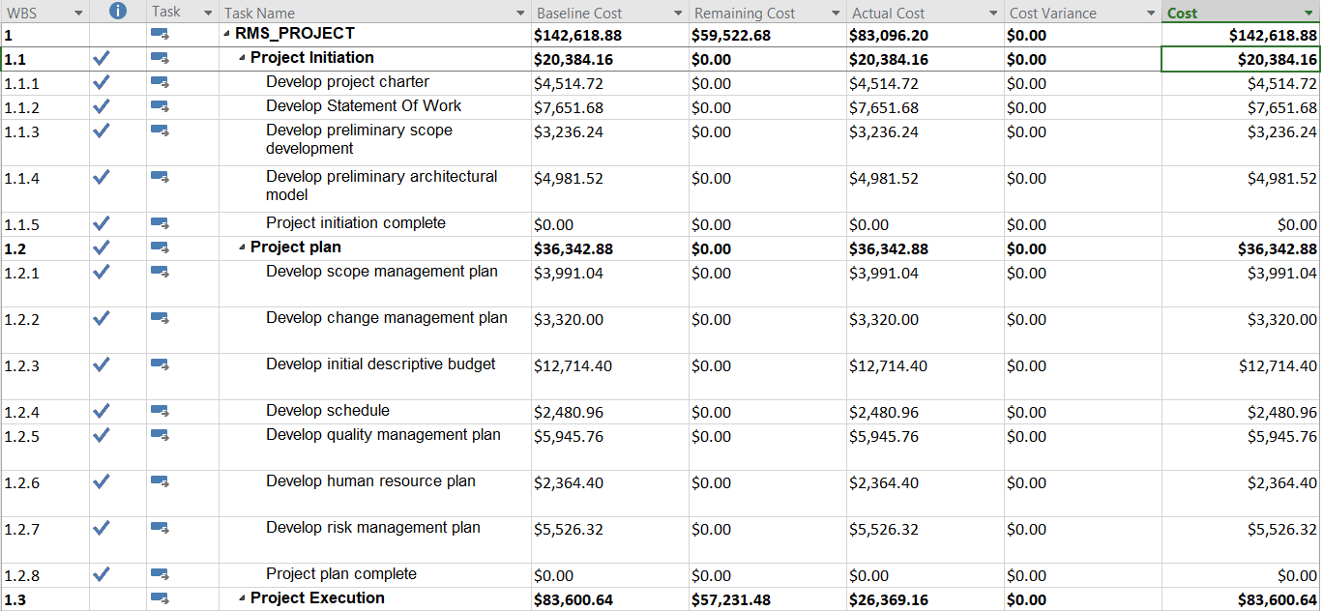
COST MANAGEMENT

Slide 19
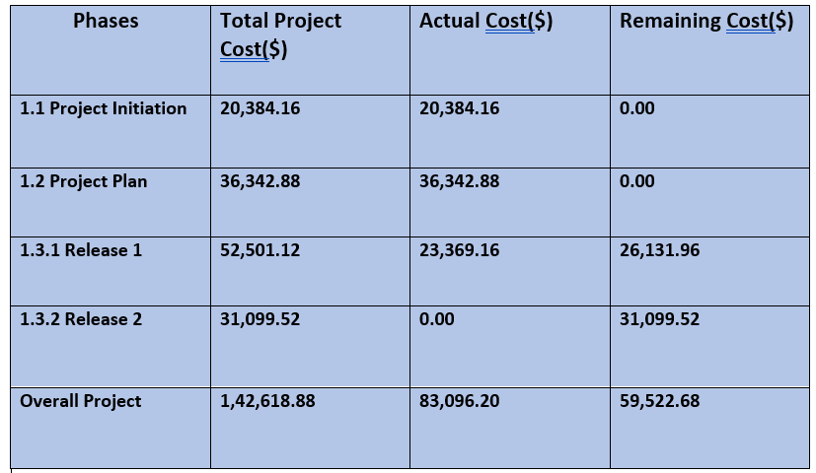
Project budget

Slide 20
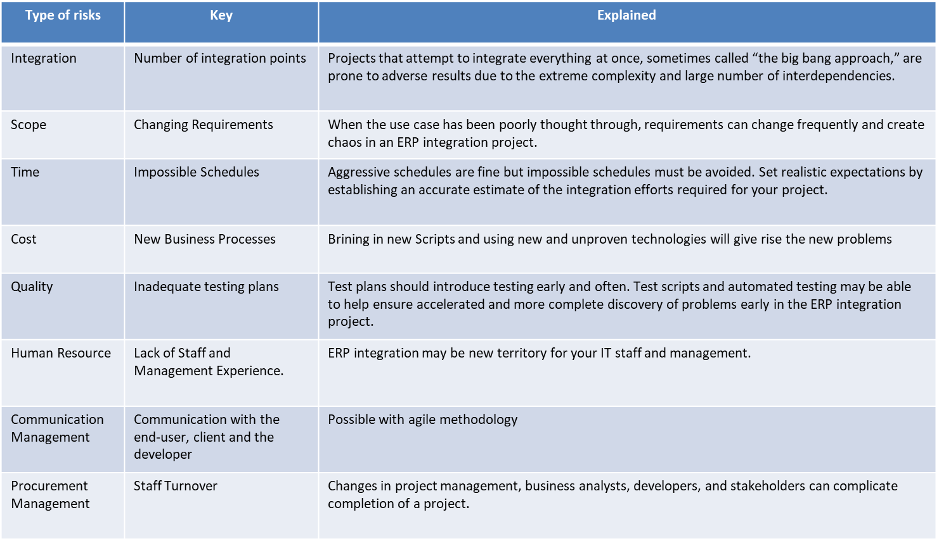
TYPES OF RISKS

Slide 21
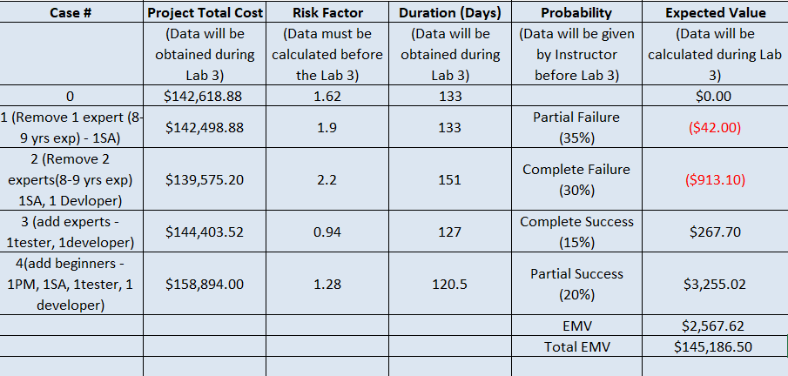
RISK MANAGEMENT PLAN

Slide 22
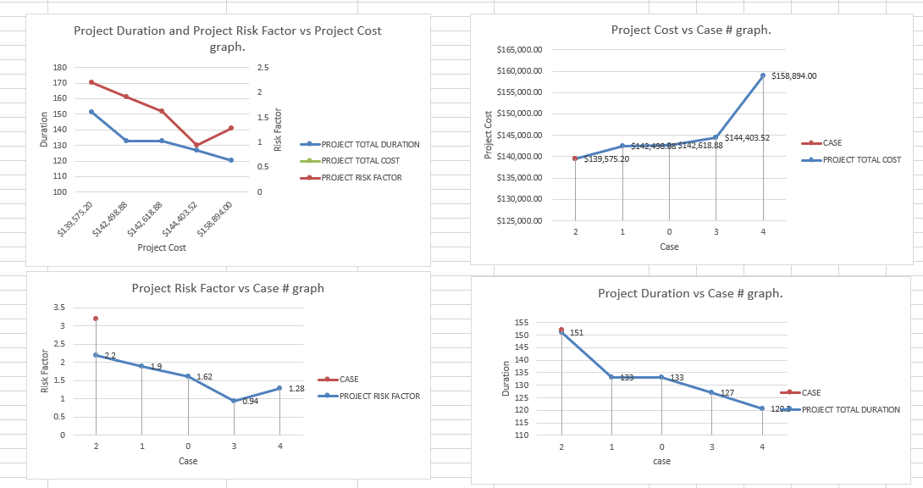
Project risk graphs

Slide 23
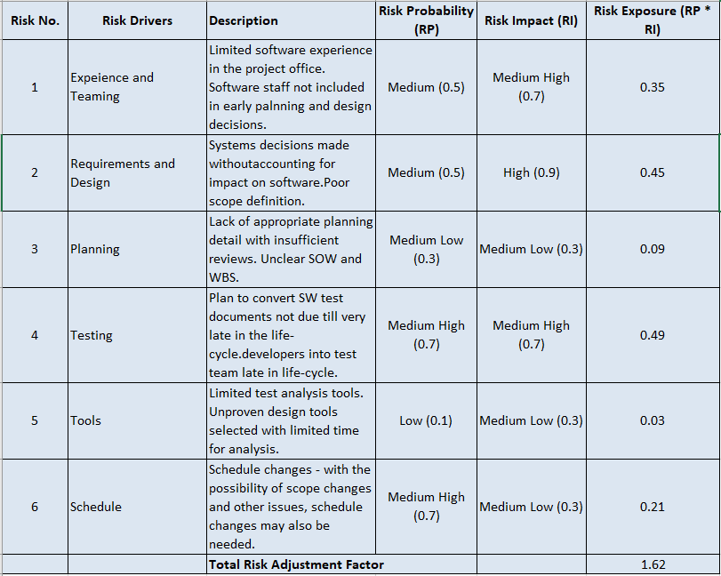
Risk exposure table

Slide 24
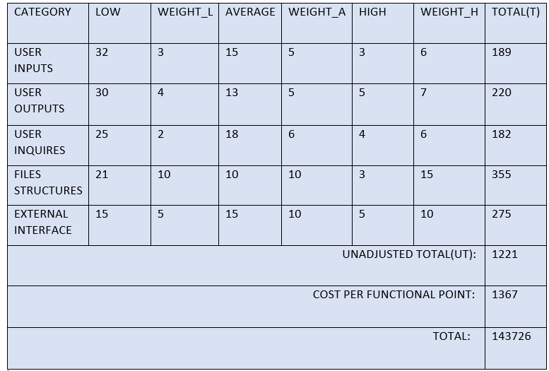
FUNCTION-POINT

Slide 25
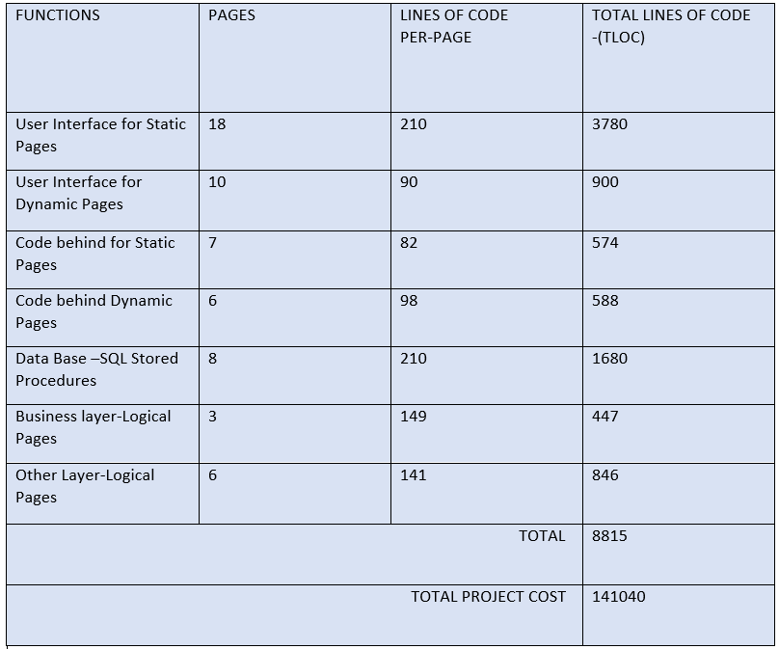
Lines-of-code estimation

Slide 26
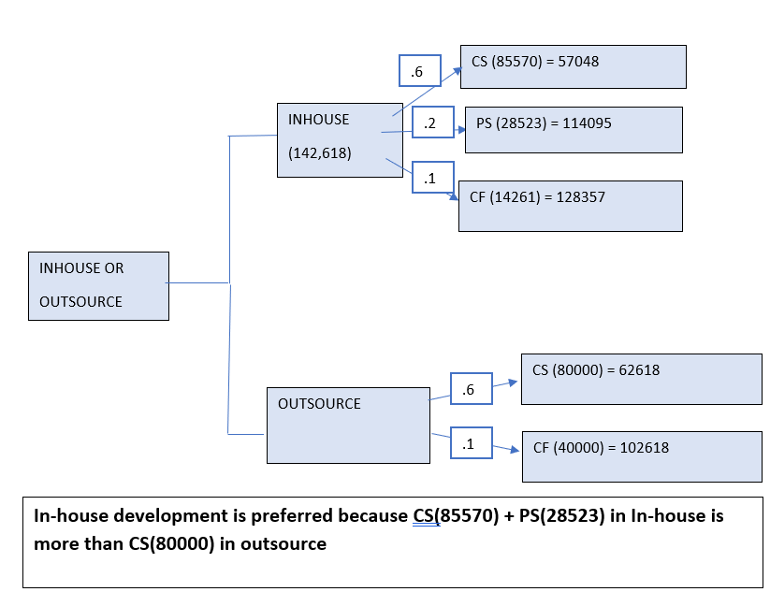
EMV DECISION TREE

Slide 27
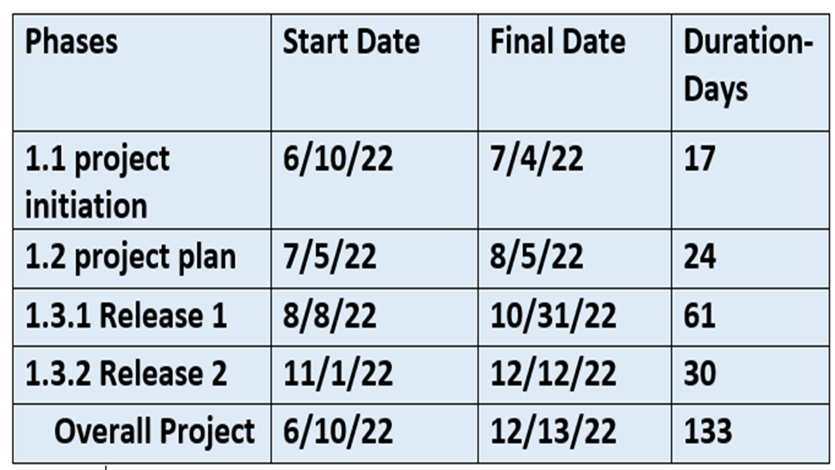
STATEMENT OF WORK
TITLE :
RISK MANAGEMENT SOFTWARE SYSTEM
INTRODUCTION :
Risk management software helps you identify, assess, and document risks associated with running various business processes and IT assets, communicate about risks, and efficiently manage risk mitigation tasks.
OBJECTIVES :
Main objectives of rms system are to predict, monitor, review and track the risks of the on-going project and report the risks as required.
MILESTONES :

Slide 28
Statement of work
Project schedule :
Project start date : 6/10/22
project end date : 12/13/22
Work requirements :
define tasks & deligate resources
analyze risks and provide solutions
Critical success factors :
System performance
Risk predictions and reporting
tracking risk changes

Slide 29
REQUEST FOR PROPOSAL
Background :
Essential rms is a software company which provides risk management softwares to various industries and keeps up with the new risks and market changes.
Project goal :
the purpose of rms is to review and report risks as soon as possible and continuously monitor the workflow to minimize delays and issues during development.
Schedule :
BIDS SHALL BE FIRM OFFERS AND REMAINS VALID FOR ACCEPTANCE 60 DAYS FOLLOWING RFQ.
STATEMENT OF WORK :
DETAILS ENCLOSED IN STATEMENT OF WORK
TECHNOLOGY CONSTRAINTS :
DETAILS ENCLOSED IN STATEMENT OF WORK

Slide 30
REQUEST FOR PROPOSAL
ELEMENTS OF PROPOSAL :
Experience of minimum 5yrs in risk management
knowledge on Risk management and reduction
Additional options :
you can integrate new rms into development system and can propose alternate solutions for implemented methods.
Evaluation criteria :
Proposals will be evaluated based on previous experience in risk management systems, time to completion and price.
Vendor reference :
Vendors should provide their contact for further processes.

Slide 31
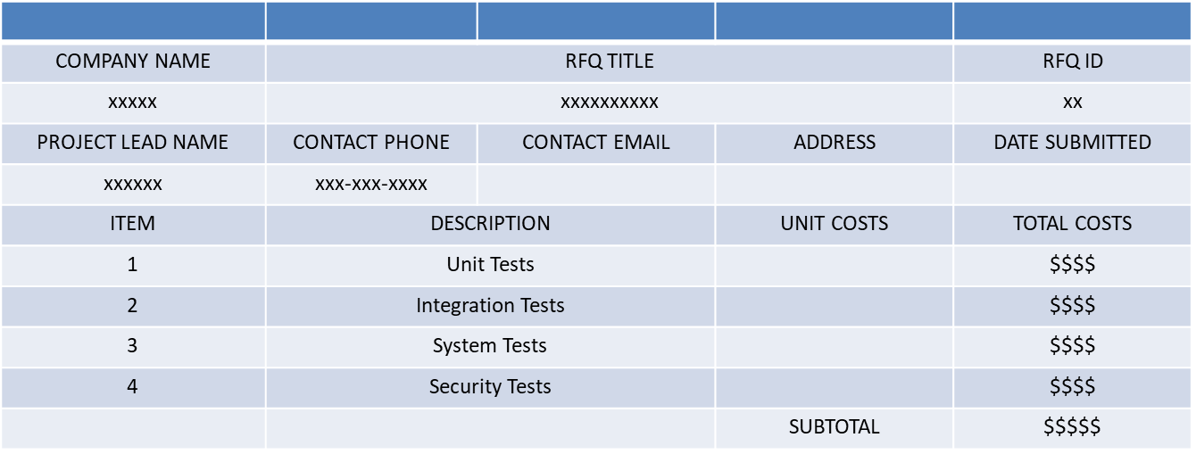
REQUEST FOR QUOTE

Slide 32
THANK YOU

